Slide 1


VISVESVARAYA TECHNOLOGICAL UNIVERSITY
JNANASANGAMA, BELAGAVI -590 014
S J M INSTITUTE OF TECHNOLOGY, CHITRADURGA
DEPARTMENT OF COMPUTER SCIENCE & ENGINEERING
2023-2024
PROJECT PHASE-2 18CSP83
PRESENTATION ON
“Vitamin Deficiency Detection Using Image Processing and Neural Network”
Submitted by,
LIKHITH KUMAR V 4SM20CS029
PRASAD C R V 4SM20CS050
RAHUL R C 4SM20CS055
SANDEEP M N 4SM20CS067
Under the Guidance of
Prof. Ramesh B E _{MCA, M.Tech.,}
Asso. Prof., Dept. of CS&E,
S.J.M.I.T, CHITRADURGA
Project coordinator
Prof. Ramesh B E _{MCA, M.Tech.,}
Asso. Prof. Dept. of CS&E,
S.J.M.I.T, CHITRADURGA
Head of the Department
Prof. Poral Nagaraj _{B.E., M.Tech.,}
Asso. Prof. & Head, Dept. of CS&E,
S.J.M.I.T, CHITRADURGA

Slide 2
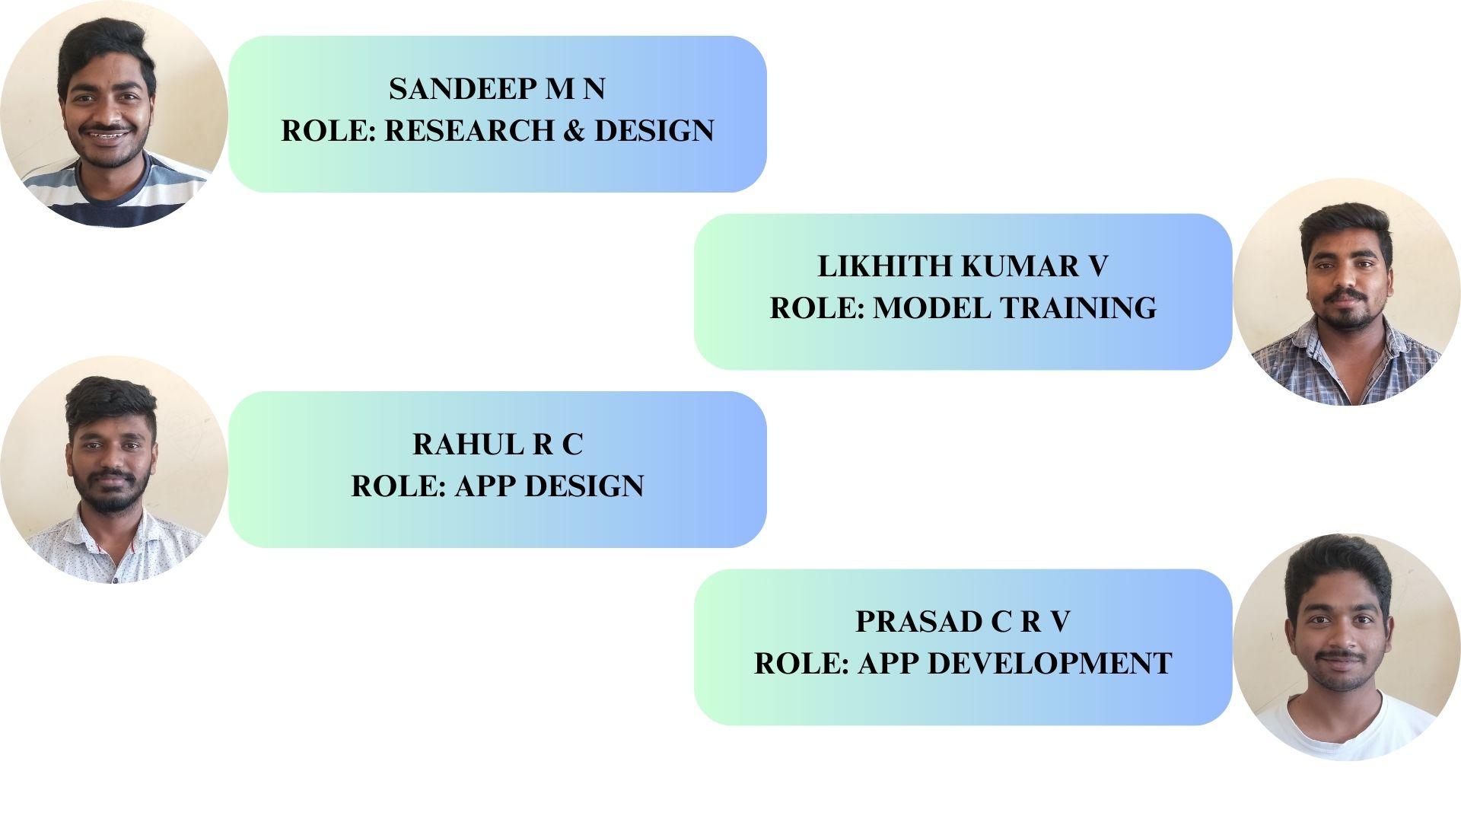
ROLES AND RESPONSIBILITIES

Slide 3
CONTENTS
ABSTRACT
INTRODUCTION
LITERATURE SURVEY
PROBLEM STATEMENT
OBJECTIVES
IMPLIMENTATION
SOFTWARE & HARDWARE REQUIREMENTS
FLOWCHART
SYSTEM DESIGN
SNAPSHOTS
LIMITATIONS
FUTURE ENHANCEMENT
CONCLUSION
REFERENCES

Slide 4
ABSTRACT
Our project aims to develop an Android app for identifying different nail diseases.
We are creating a user-friendly app with features like login/registration, image capture, and results screens.
Our app uses image processing technology to analyze nail images and provide accurate results.
By offering a convenient tool for detecting nail diseases, our app can contribute to early diagnosis and better healthcare outcomes.
Through this project, we aspire to make nail disease detection more accessible and effective for users worldwide.

Slide 5
INTRODUCTION
Our main priority in the project is user health.
Nail health serves as a critical indicator of overall well-being, often reflecting underlying medical conditions.
Our project aims to empower users with a convenient tool for early detection and management of nail diseases.
We provide users with accessible means to monitor and assess their nail health from the comfort of their homes.
We prioritize user experience by designing a simple and intuitive interface.
Our app's features, including login, registration, image capture, and result display,

Slide 6
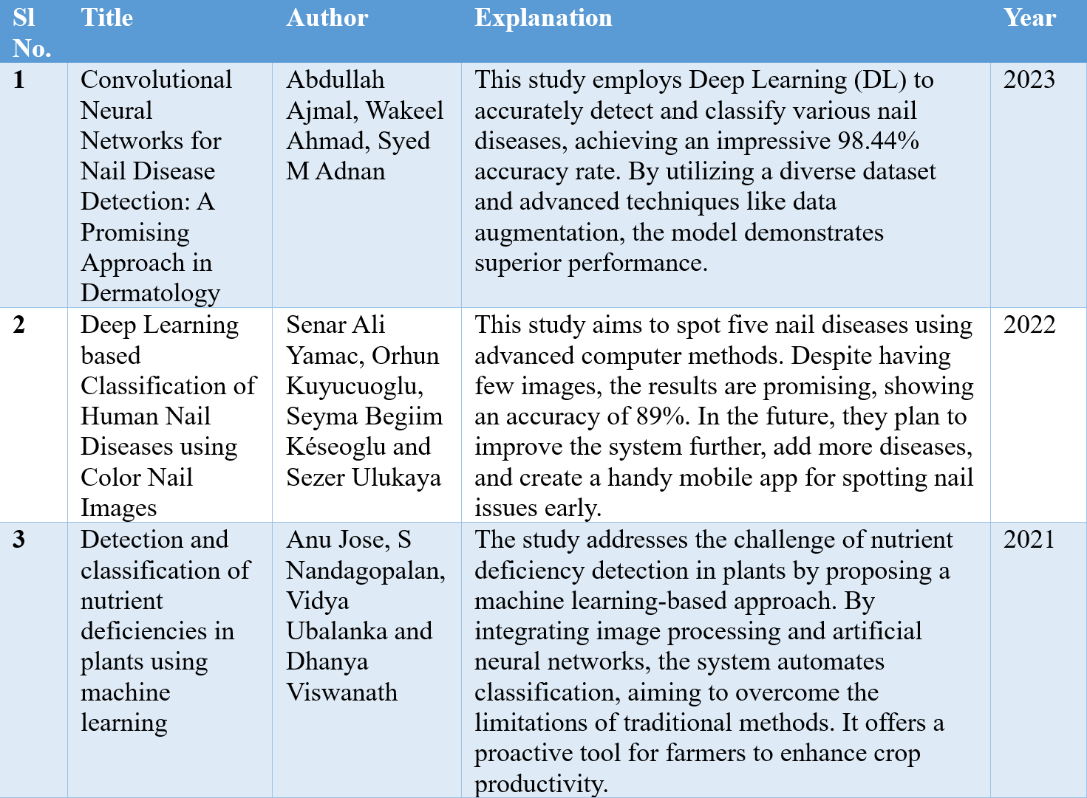
LITERATURE SURVEY

Slide 7
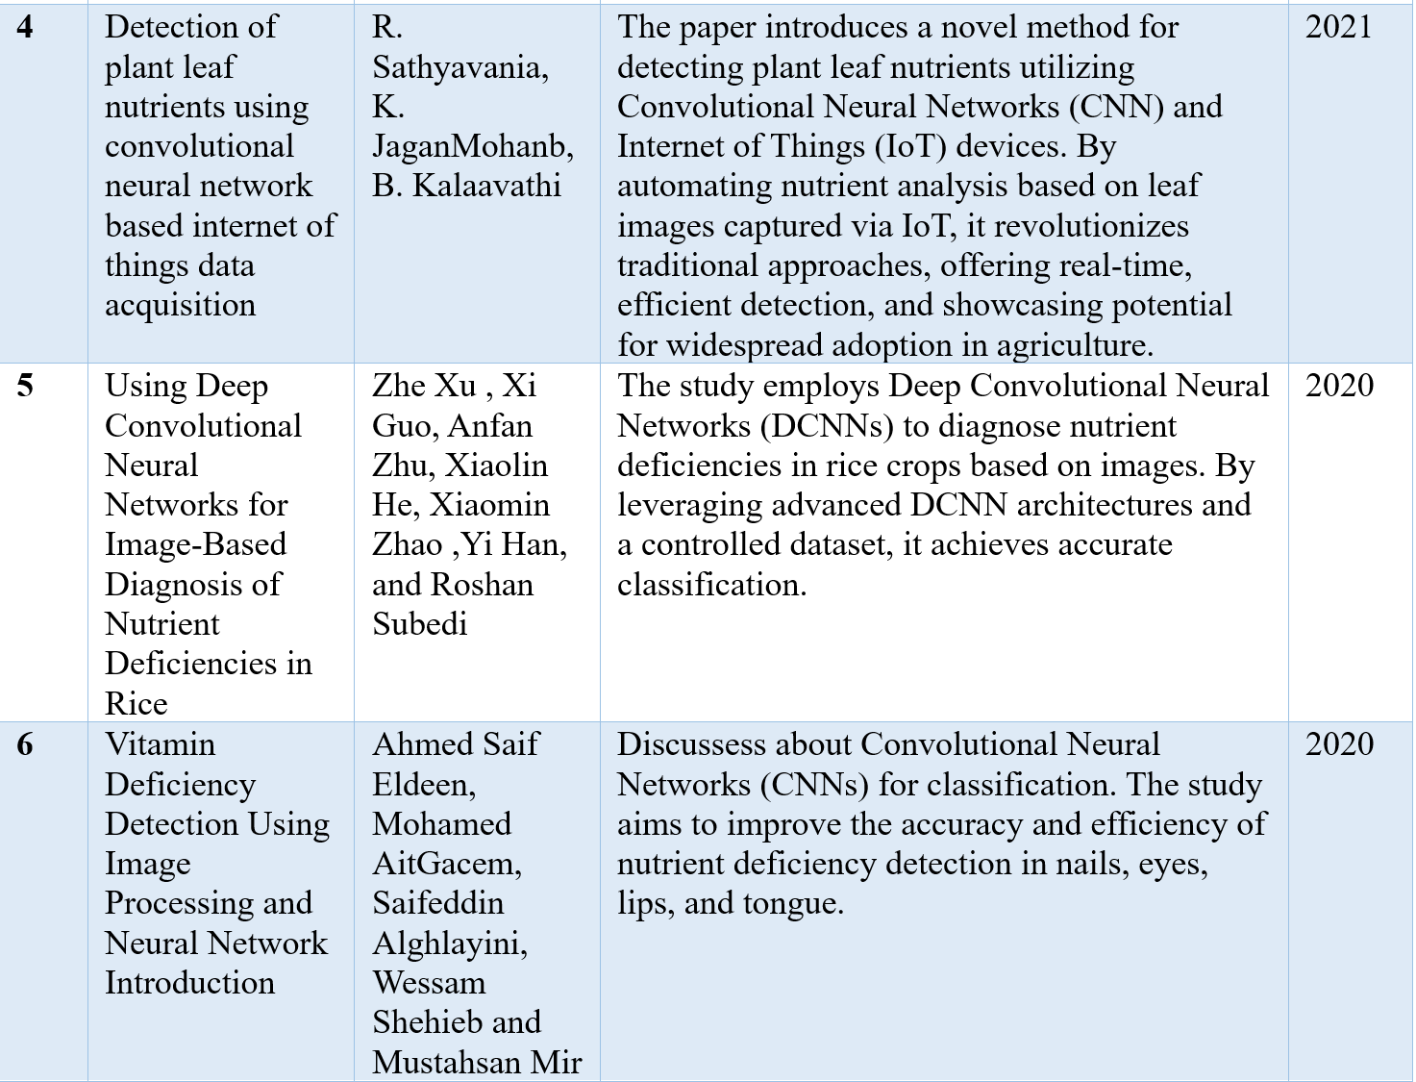
Cont.…

Slide 8
PROBLEM STATEMENT
Identifying Nail Diseases: Recognizing nail diseases early is crucial for prompt treatment and management.
Complexity in Diagnosis: Diagnosing nail diseases accurately often requires specialized medical knowledge and expertise.
Accessibility to Healthcare: Many individuals face barriers to accessing healthcare professionals for routine nail examinations.
Subjectivity in Observation: Visual examination of nails by individuals may not always lead to accurate identification of diseases due to subjective interpretation.
Time Constraints: Traditional diagnostic methods can be time-consuming, delaying necessary interventions and treatments.

Slide 9
OBJECTIVES
Develop a system capable of identifying various nail diseases to facilitate timely intervention.
Empower users to monitor and assess their nail health conveniently using a mobile application.
Provide accessible means for individuals to perform self-assessment of nail health, especially in areas with limited access to healthcare professionals.
Educate users about different nail diseases and provide them with dietary precautions.
Create a user-friendly interface that allows for easy navigation and seamless interaction with the application's features.

Slide 10
IMPLEMENTATION
Technologies used:
Visual Studio Code - IDE for Training & Testing the model.
Android Studio - IDE for developing android application.
Programming languages:
Python - For Training & Testing the model.
Kotlin - For app development.
Machine Learning Model:
Support Vector Machine (SVM) algorithm for the classification of nail diseases based on input images.

Slide 11
SOFTWARE & HARDWARE REQUIREMENTS
For development:
Operating system: Windows 10/11
Development environment: Android Studio & Visual Studio Code
Processor: Minimum Intel i3 11th gen
RAM: Minimum 8GB
Storage: Minimum 15GB of free space
At User-End:
Smartphone with camera
Operating system: Android 7 & above
RAM: Minimum 2GB

Slide 12
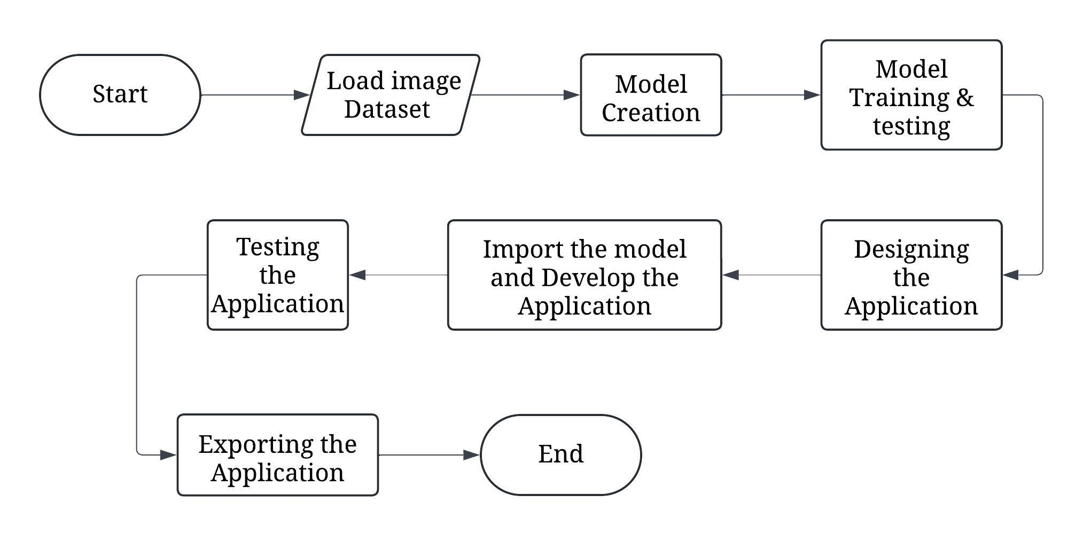
FLOWCHART
Fig 1: Flow of our project development

Slide 13
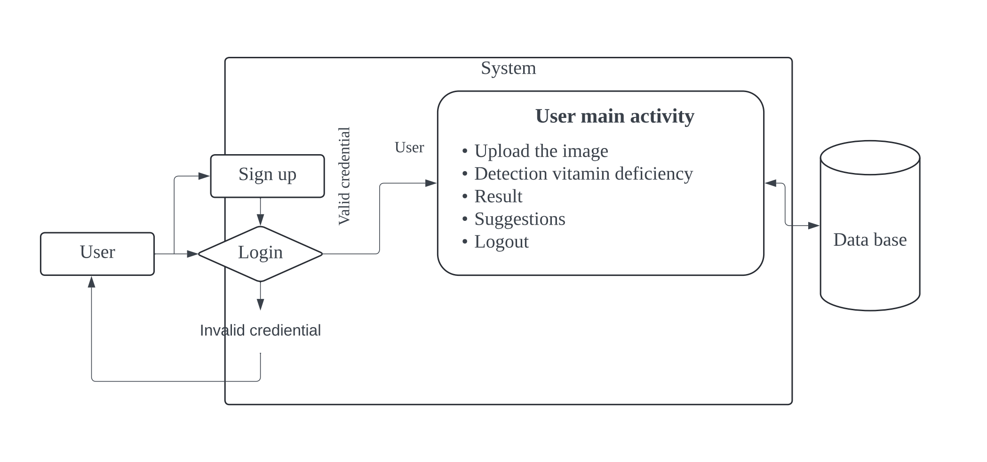
SYSTEM DESIGN
Fig 2: Architecture of Android Application

Slide 14
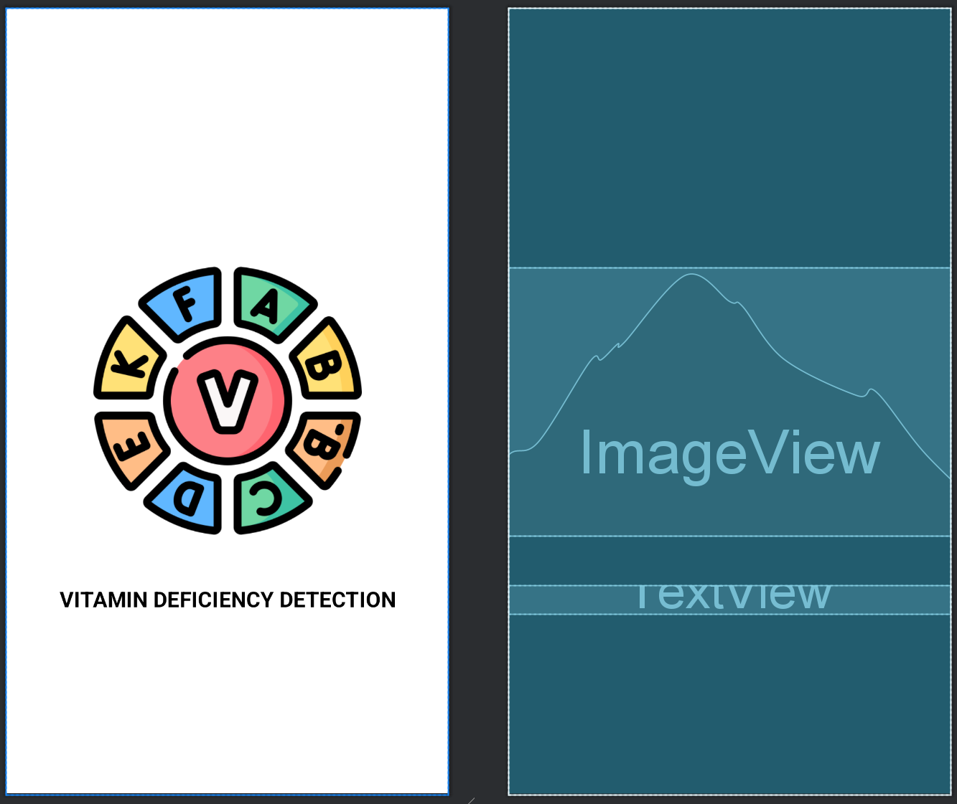
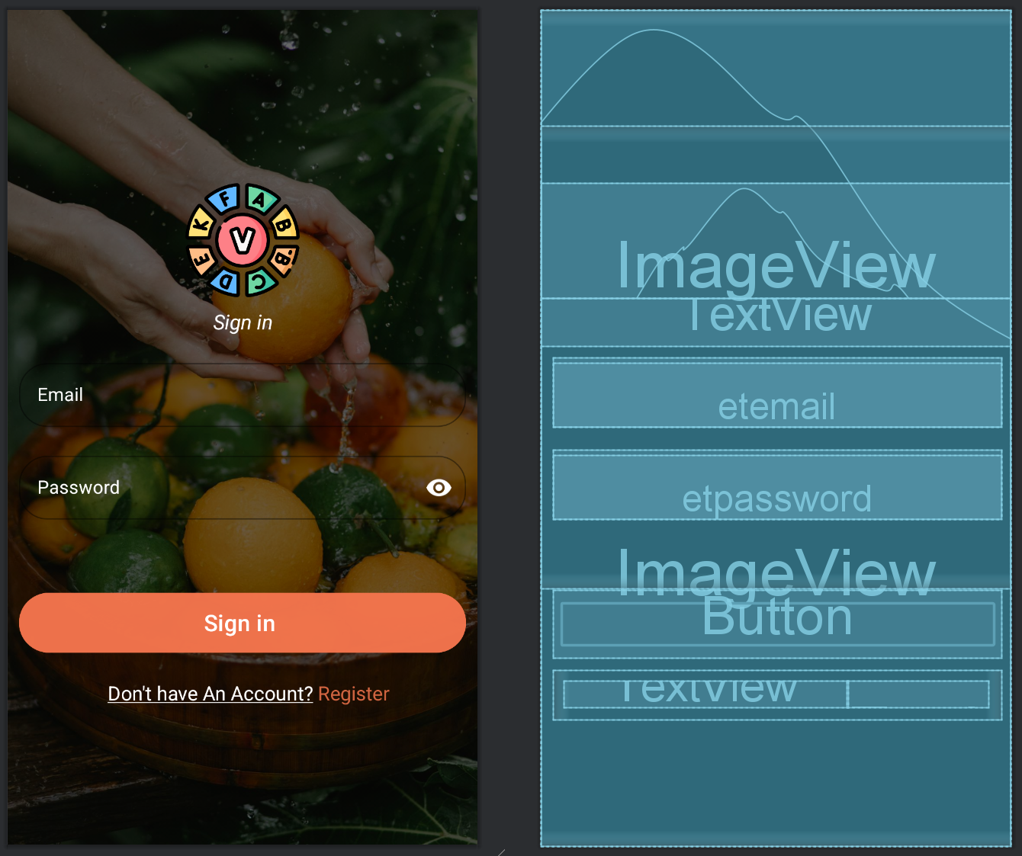
SNAPSHOTS
Fig 3: Design & blue print of
INITIAL SCREEN
Fig 4: Design & blue print of
SIGN IN SCREEN

Slide 15
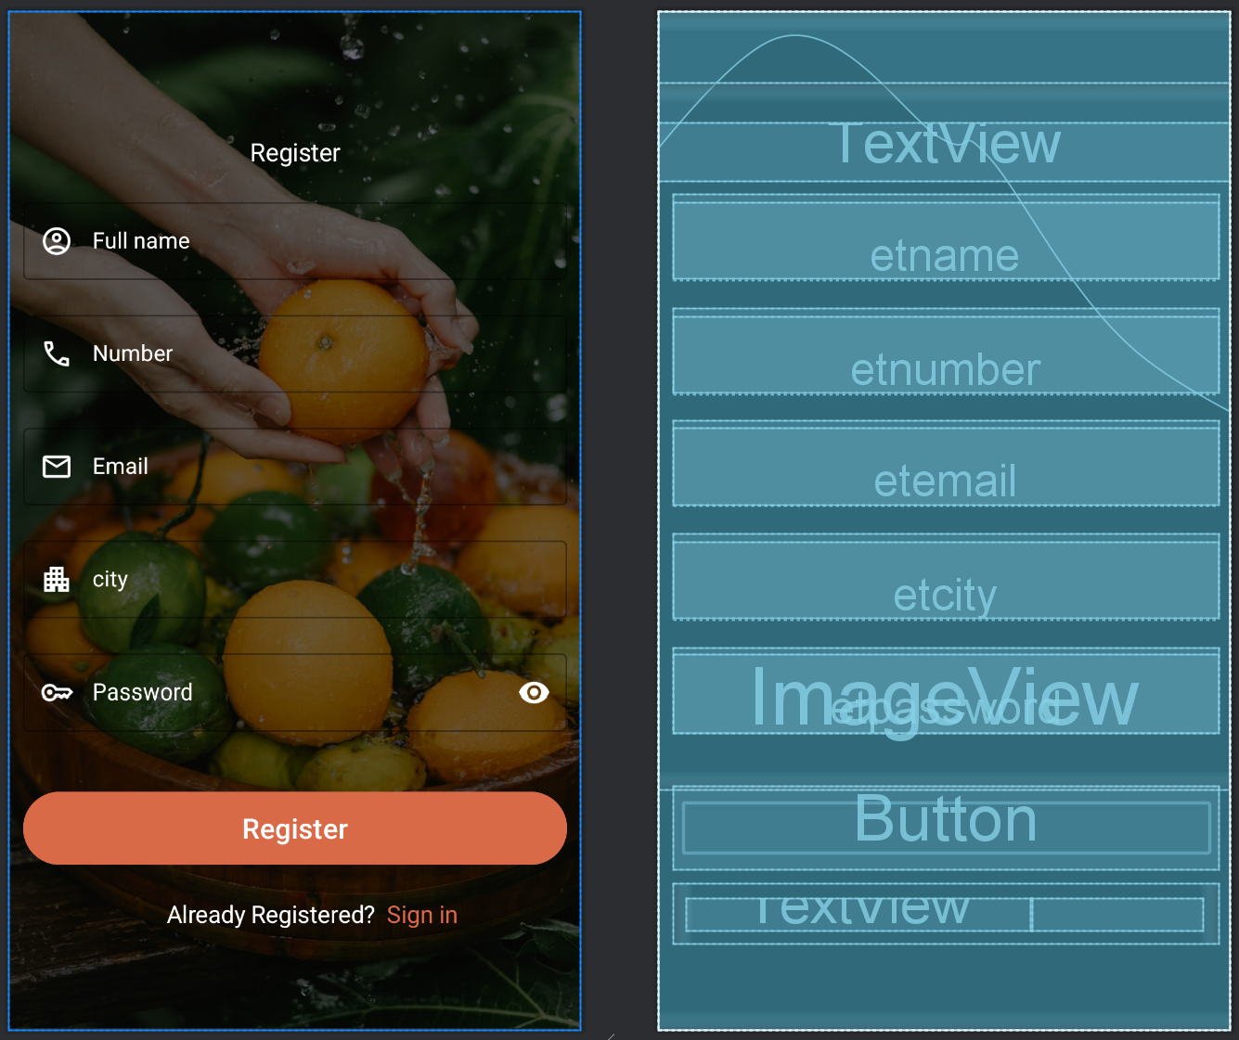
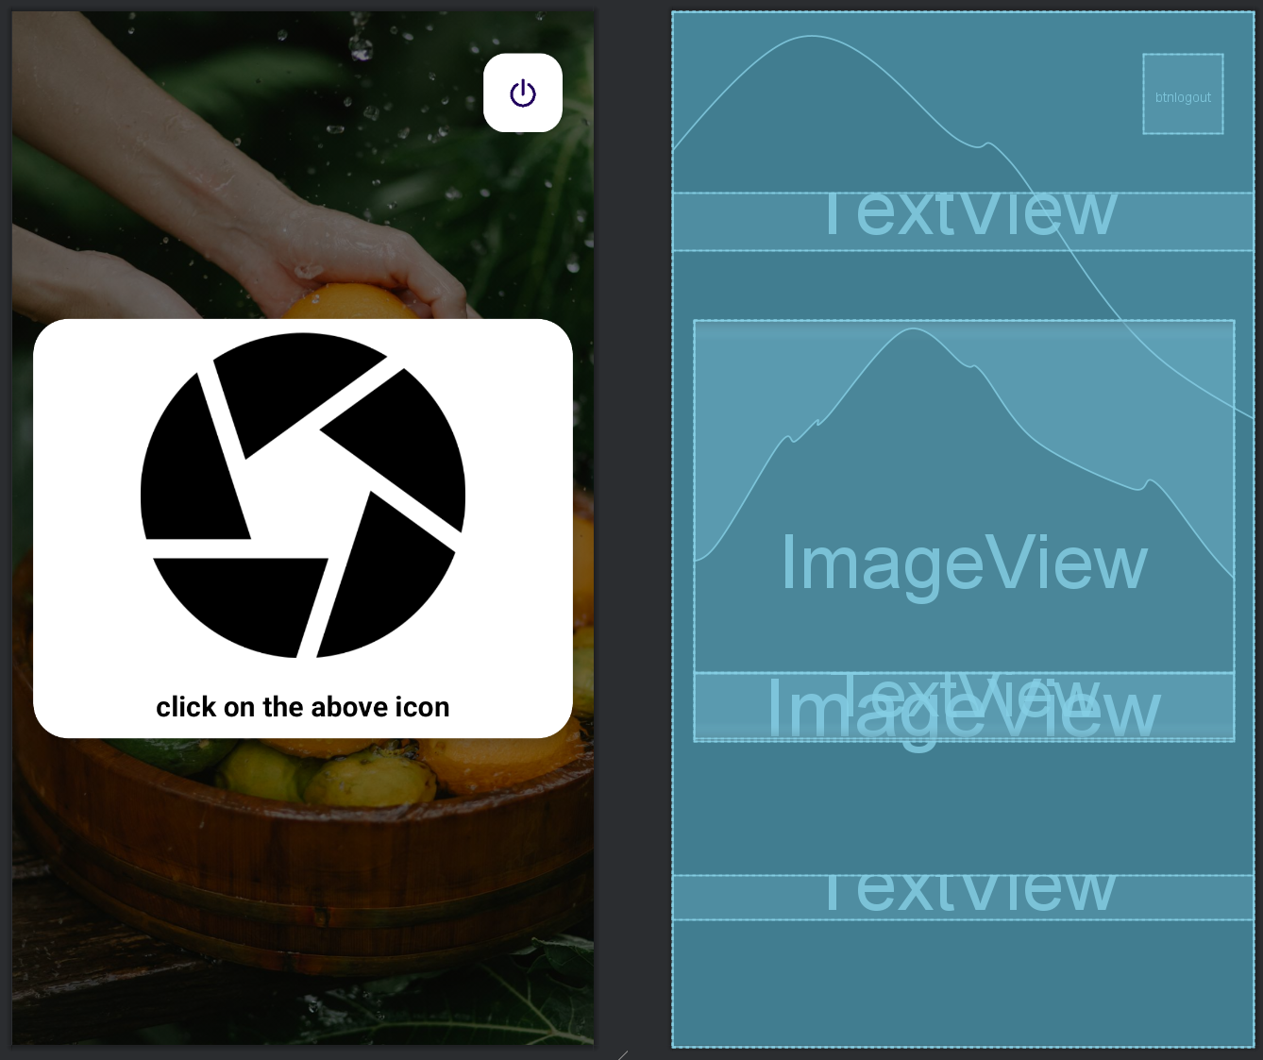
Cont.…
Fig 5: Design & blue print of
REISTER SCREEN
Fig 6: Design & blue print of
IMAGE CAPTURE SCREEN

Slide 16
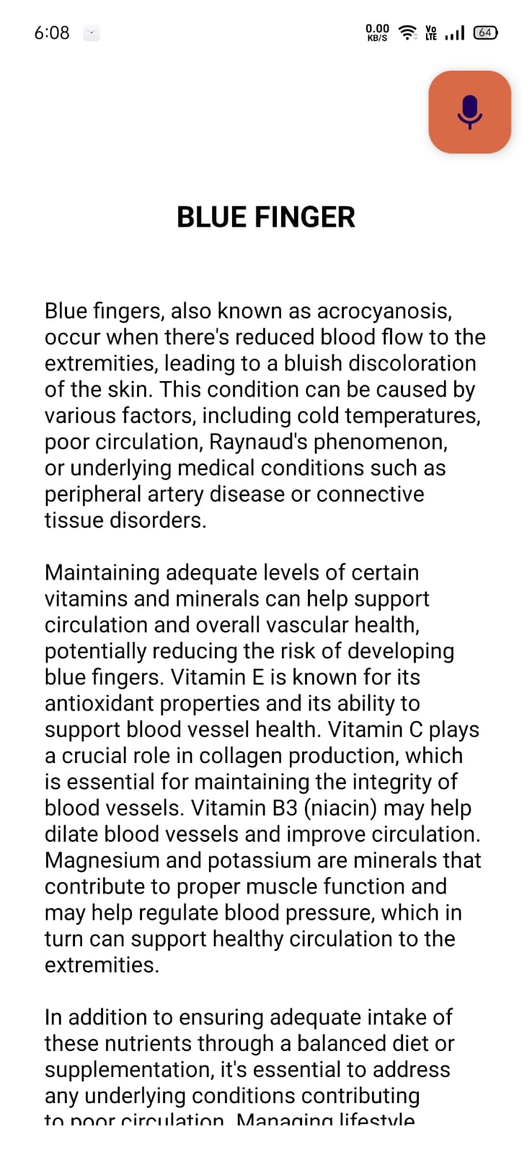
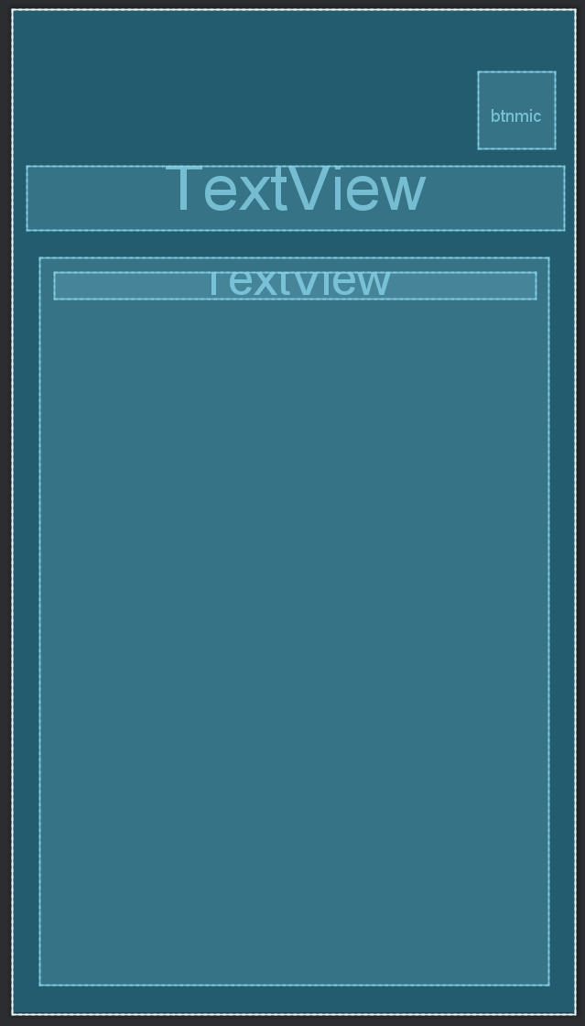
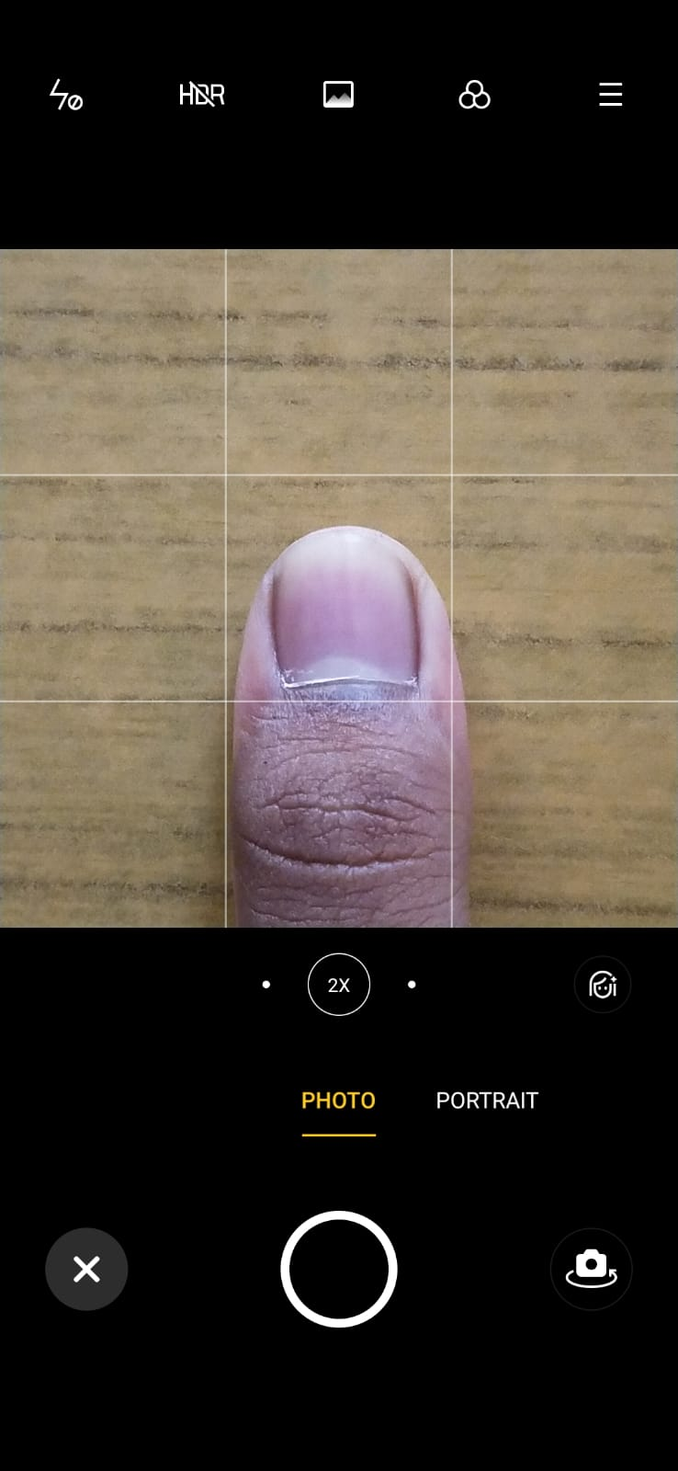
Cont.…
Fig 7: CAMERA PREVIEW
Fig 8: Design & blue print of
RESULT SCREEN

Slide 17
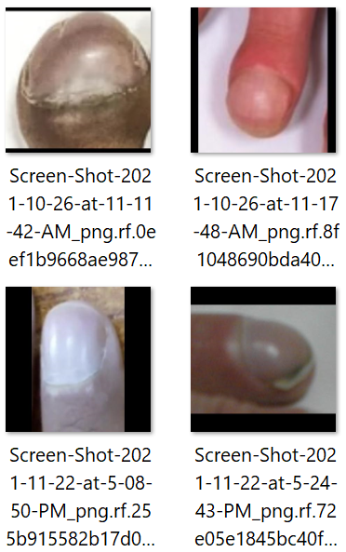
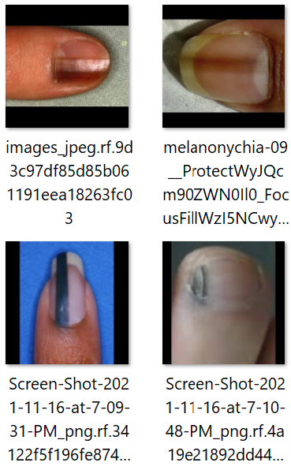
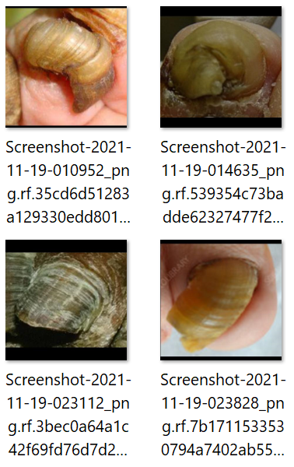
Cont.…
Some of the Sample dataset used for training the model:
Fig 9: Clubbing
Fig 10: Acral Lentiginous Melanoma
Fig 11: Onychogryphosis

Slide 18
LIMITATIONS
Limited Image Data: We used about 400 images to train the model, but this might not be enough for it to understand all nail problems well. That's why it's only about 44.30% accurate.
Image Quality Matters: If the training dataset consists of low-quality images or if pictures are unclear or different sizes, it can confuse the model and reduce its accuracy.
Inefficient Image capture: Since people might take blurry or unclear images of their nails while using the app, the model can struggle to learn and predict accurately.
Only Covers Some Nail Problems: Currently, the model can only recognize a limited number of nail problems : Acral Lentiginous Melanoma, Beau's Line, Blue Finger, Clubbing, Koilonychia, Muehrcke's Lines, Onychogryphosis, Pitting, Terry Nail.

Slide 19
FUTURE ENHANCEMENT
Collect More and Higher Quality Dataset: In future enhancements, we plan to gather a larger and better-quality dataset to improve the model's accuracy and robustness.
Utilize Cloud for Data Storage: We aim to integrate cloud storage to securely store user images, allowing for continuous model training and refinement.
Incorporate Additional Datasets: To broaden the scope of our application, we intend to include datasets related to other health indicators such as eyes, lips, and tongue, enabling comprehensive health assessment capabilities.
Explore Alternative Image Classification Algorithms: In our pursuit of enhancing the model's performance, we will investigate and experiment with other advanced image classification algorithms to identify potential alternatives that could offer improved accuracy and efficiency.

Slide 20
CONCLUSION
In conclusion, our project marks a significant milestone in healthcare technology, particularly in the domain of early nail disease detection and management. By seamlessly integrating image processing techniques and machine learning algorithms, we have successfully developed a tool that empowers users to monitor their nail health from their homes. While we acknowledge the existing limitations, such as concerns regarding accuracy and the coverage of only a subset of nail problems, our project sets the stage for future advancements in this field. Moving forward, our dedication remains as we strive to refine our model, expand the dataset with more diverse and high-quality images, and explore algorithms to enhance accuracy and usability. With a commitment to continuous improvement and innovation, we see our project playing a role in early diagnosis and prevention strategies for nail diseases, thereby contributing to improved healthcare outcomes for users worldwide.

Slide 21
REFERENCES
[1] Abdullah Ajmal, Wakeel Ahmad, Syed M Adnan "Convolutional Neural Networks for Nail Disease Detection: A Promising Approach in Dermatology",2023.
[2] Senar Ali Yamac, Orhun Kuyucuoglu, Seyma Begiim Késeoglu and Sezer Ulukaya "Deep Learning based Classification of Human Nail Diseases using Color Nail Images",2022.
[3] Anu Jose, S Nandagopalan, Vidya Ubalanka and Dhanya Viswanath "Detection and classification of nutrient deficiencies in plants using machine learning",2021.
[4] R. Sathyavania, K. JaganMohanb, B. Kalaavathi "Detection of plant leaf nutrients using convolutional neural network based internet of things data acquisition",2021.
[5] Zhe Xu , Xi Guo, Anfan Zhu, Xiaolin He, Xiaomin Zhao ,Yi Han, and Roshan Subedi "Using Deep Convolutional Neural Networks for Image-Based Diagnosis of Nutrient Deficiencies in Rice",2020.
[6] Ahmed Saif Eldeen, Mohamed AitGacem, Saifeddin Alghlayini, Wessam Shehieb and Mustahsan Mir "Vitamin Deficiency Detection Using Image Processing and Neural Network Introduction",2020.

Slide 22
THANK YOU…

